Slide 1
LWC Training
Creating Lightning Web Component
MAY 13, 2019
Day 5: Creating Lightning Web Component

Slide 2
Agenda
agenda
Define a Component – HTML, CSS, JavaScript, Composition
Access Salesforce Data
Hands on Challenge

Slide 3
Define a Lightning Web Component

Slide 4
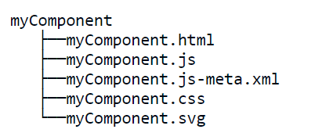
Define a Component
Define a lightning web component
A Lightning web component that renders UI must include an HTML file, a JavaScript file, and a metadata configuration file.
The files must use the same name so the framework can autowire them.
A service component (library) must include a JavaScript file and a metadata configuration file.
Component Folder
Must begin with a lowercase letter
Must contain only alphanumeric or underscore characters
Must be unique in the namespace
Can’t include whitespace
Can’t end with an underscore
Can’t contain two consecutive underscores
Can’t contain a hyphen (dash)

Slide 5
HTML Templates
Define a lightning web component
LWC uses templating system, which uses Virtual DOM to render components smartly and efficiently.
A template is a valid HTML with a <template> root tag.
When a component renders, the <template> tag is replaced with the name of the component, <namespace-component-name>.
Directives are special HTML attributes, like if:true and for:each, that give you more power to manipulate the DOM in markup.
HTML templates also render data to the DOM. Use simple syntax to declaratively bind a component’s template to data in the component’s JavaScript class.

Slide 6
HTML Templates (Contd.)
Define a lightning web component
Every component must have a JavaScript file.
Data Binding in a Template :
Bind properties in a component’s template to properties in the component’s JavaScript class.
Render DOM Elements Conditionally :
To render HTML conditionally, add the if:true|false directive to a nested <template> tag that encloses the conditional content.
Render Lists :
To render a list of items, use for:each directive or the iterator directive to iterate over an array.
Add the directive to a nested <template> tag that encloses the HTML elements you want to repeat.

Slide 7
CSS
Define a lightning web component
Use of CSS or Lightning Design System to design Lightning Components
Three Ways of using CSS on the components:
Style Components with Lightning Design System
Aura Styles and Design Tokens
Create a CSS Style Sheet for a Component

Slide 8
CSS (Contd.)
Define a lightning web component
Style Components with Lightning Design System
Salesforce Lightning Design System is a CSS framework that provides a look and feel that’s consistent with Lightning Experience.
it just works with Lightning components running in Lightning Experience and in the Salesforce mobile application.

Slide 9
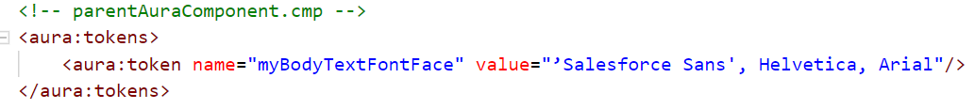
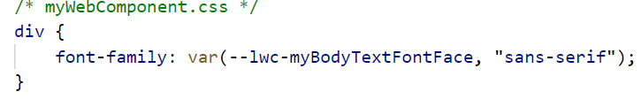
CSS (Contd.)
Define a lightning web component
Aura Styles and Design Tokens
Lightning web components inherit CSS style from Aura components and apps
Use CSS variables in a Lightning web component to reference Aura design tokens
Design tokens are named entities that store visual design attributes, such as margins and spacing values, font sizes and families, or hex values for colors

Slide 10
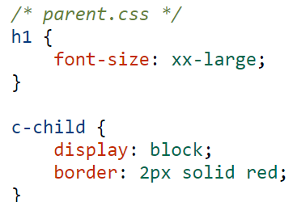
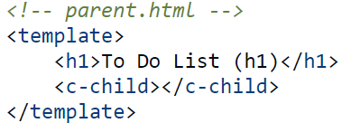
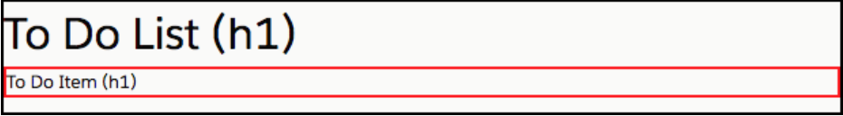
CSS (Contd.)
Define a lightning web component
Create a CSS Style Sheet for a Component
To bundle styles with a component, create a style sheet in the component’s folder
The style sheet must have the same name as the component
Each component can have only one style sheet
parent component can style a child component, but it styles it as a single element
Output

Slide 11
JavaScript
Define a lightning web component
Every component must have a JavaScript file.
Component JavaScript Properties:
Declare properties and reference the properties to dynamically update the content.
Share Script Code:
Create ES Module and export the variables or functions
Use Third Party JavaScript Libraries :
Ability to use third party JavaScript libraries
Call API from JavaScript :
Ability to make API calls using remote site as CSP trusted site

Slide 12
Component JavaScript Properties
Define a lightning web component
3 Types of Properties
Reactive Properties
If reactive property changes, the component re-renders
Can be public or private
All the expressions are reevaluated
Private Properties
Can be used only by the JavaScript class that defines it
Don’t use in template as they don’t re-render on change
Reflect Properties
Public JavaScript properties appear as attributes
Define getter and setter
Property Names (naming conventions)
Property names in JavaScript are in camel case
HTML attribute names are in kebab case (dash-separated)
Ex: A JavaScript property named itemName maps to an HTML attribute named item-name
Access HTML Global Attributes in JavaScript
Ex: Access accesskey HTML attribute as accessKey in JavaScript file
Access ARIA Attributes in JavaScript
Ex: Access aria-checked, use ariaChecked.

Slide 13
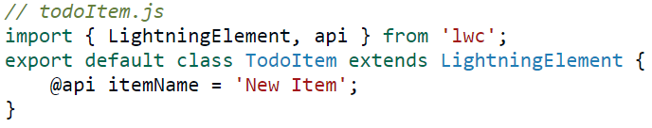
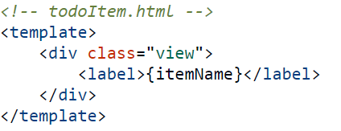
Public Properties (Reactive Properties)
Define a lightning web component
2 Types of Reactive Properties
Public Properties
To expose a public property, decorate it with @api
Public properties define the API for a component
Public properties are reactive
When you use the @api decorator, you must import it explicitly from lwc
To execute logic each time a public property is set, write a custom setter

Slide 14
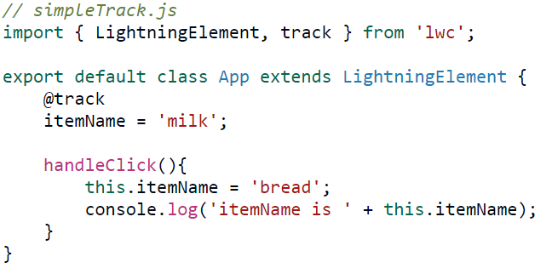
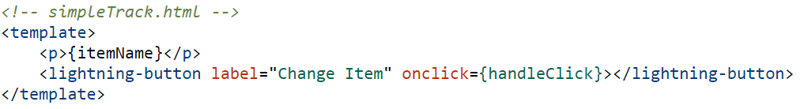
Tracked Properties (Reactive Properties)
Define a lightning web component
Decorate the property with @track to track a private property’s value and rerender a component when it changes
Tracked properties are also called private reactive properties
Access tracked property directly in a template
Can use getter setter for tracked properties
Don’t overuse @track. Track a property only if you need the component to rerender when the property’s value changes.

Slide 15
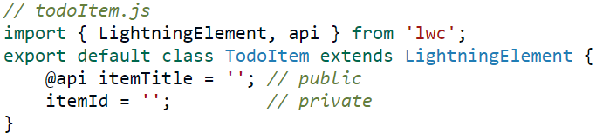
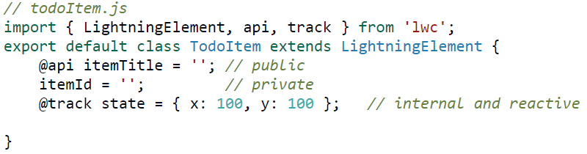
Private Properties
Define a lightning web component
A private property can be used only by the JavaScript class that defines it
Private properties aren’t reactive
A private property doesn’t have any decorator.
Can make a private property as reactive

Slide 16
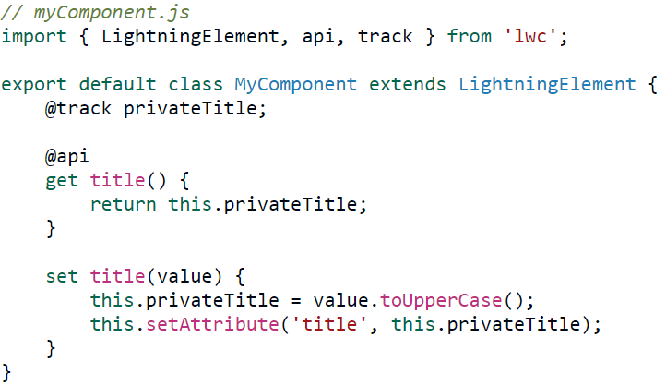
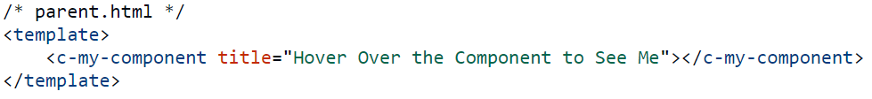
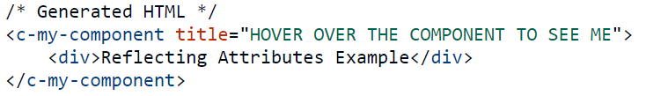
Reflect Properties
Define a lightning web component
Ability to appear/set public JavaScript properties as attributes in the rendered HTML
Helps in creating accessible components as screen readers and other assistive technologies use HTML attributes
All HTML attributes are reactive by default

Slide 17


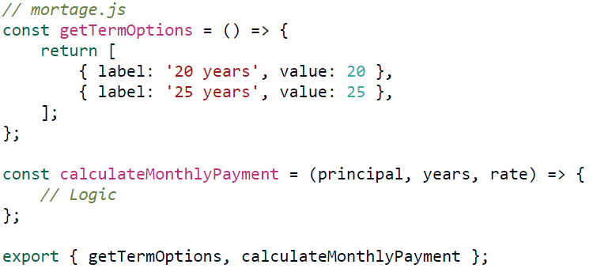
Share JavaScript Code
Define a lightning web component
Create an ES6 module and export the variables/functions that you want to share.
An ES6 module is a JavaScript file
Modules make it easier to structure your code
Two ways export functionality
Single default function or variable
Export named functions or variables

Slide 18


Use Third-Party JavaScript Libraries
Define a lightning web component
Upload third party library in Static Resource
Import Static Resource in JavaScript
Import methods from platformResourceLoader
The platformResourceLoader module has two methods - loadScript and loadStyle
Accesses a .js and .css file in a static resource. Returns a promise that resolves when the file has loaded.
self—A reference to the component. The value must be this.
fileUrl—A string that contains the path to the CSS file. To build the string, concatenate the resourceName and the path to the file within the static resource archive.

Slide 19
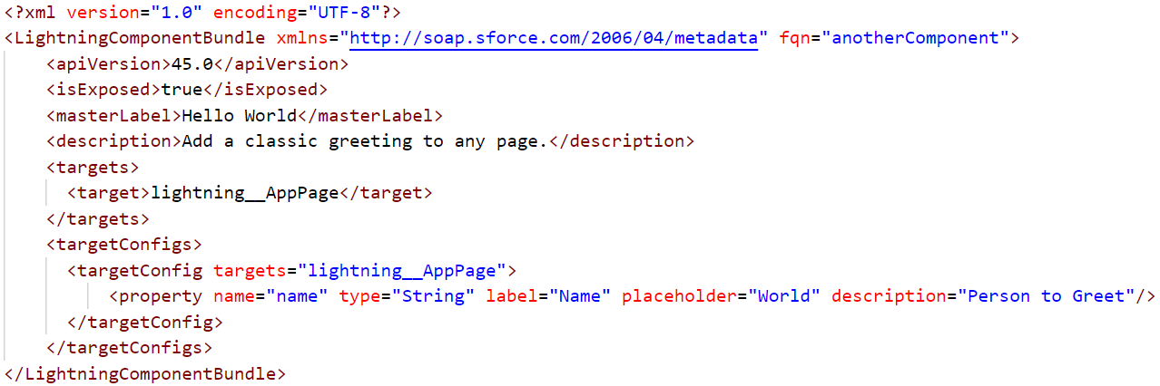
Configure the Component for Lightning App Builder
Define a lightning web component
To use the component in Lightning App Builder, set <isExposed> to true.
The <target> lets us add the component to an app page.
The <targetConfigs> section lets us set the component’s name property in Lightning App Builder.

Slide 20
Questions

Slide 21
Which attribute should you set to true in the component configuration file to view the component in the Lightning app builder?
isPublished 2. isExposed 3. isPublic 4. All of the above
A JavaScript property named itemName maps to an HTML attribute named item-name. True or False?
How can we access labels in a Lightning Web component?
Import labels from the @label scoped module
Import labels from the @salesforce/label scoped module
Import labels from the @track/label scoped module
A Lightning web component must include which mandatory files to render UI?
HTML, JS, CSS
HTML, JS, SFDX
HTML, JS, METADATA Config file
HTML, JS, CSS, CMP
What is the root tag used in any LWC html file?
<component> 2.<html> 3.<template> 4.<body>

Slide 22
Hands on Challenge

Slide 23
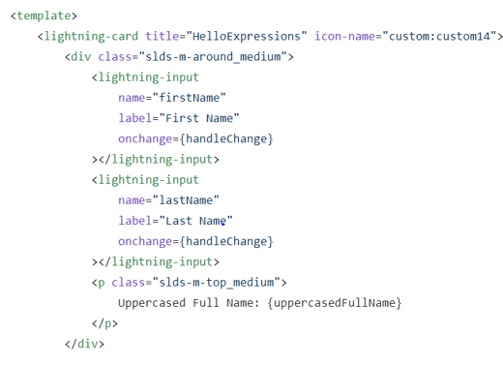
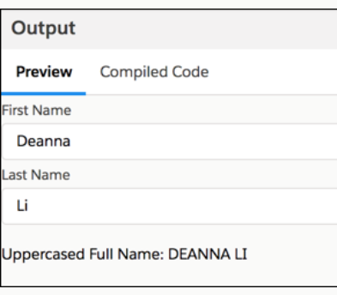
Hands on Challenge
Hands on challenge
A user enters their first and last name. A JavaScript getter computes the uppercased full name and displays it
helloExpressions.html

Slide 24
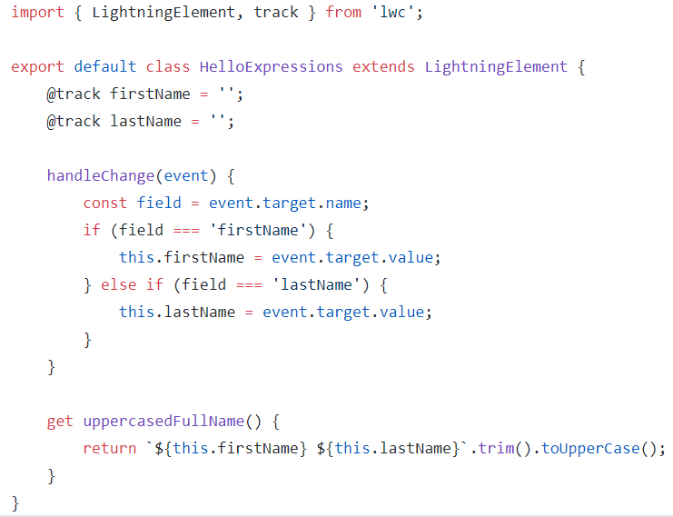
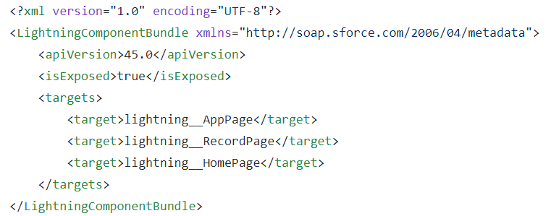
Hands on Challenge (Contd.)
Hands on challenge
helloExpressions.js
helloExpressions.js-meta.xml

Slide 25
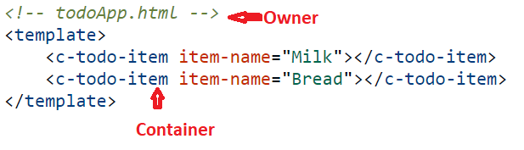
Composition
Hands on challenge
Composition enables you to build complex components from simpler building-block components. Allows us to add component within body of the another component.
Compose Components
Helps to compose apps and components with smaller and reusable components including custom and lightning namespace
LWC uses owner and container concept
Owner
Set public properties on composed components
Call methods on composed components
Listen for any events fired by the composed components
Container
Read, but not change, public properties of owner
Call methods on composed components
Listen for some, but not necessarily all, events bubbled up by components that it contains.

Slide 26
Set Properties and Call Methods on Children
Hands on challenge
Set Properties
To prorogate the values Owner can set the properties of child component
Data binding for property values is one-way
Child component must treat property values passed from the owner component as read-only
To make any changes child has to trigger event
Child component should have public property with @api decorator
Kebab casing is used to set the value from parent or owner component – known as data binding or value binding
Call Methods
Expose a public method, decorate it with @api in component
Owner and parent can call method defined in child component which is defined as public with @api
this.template.querySelector() is used to get access to a child component and call method on component
querySelector() – method is standard DOM API that returns first element that matches the selector
querySelectorAll() - returns an array of DOM Elements

Slide 27
Access Salesforce Resources

Slide 28
Access Salesforce Resources
Access salesforce resources
Lightning components can access global Salesforce values, such as labels, resources, and users.
Access Static Resources:
Import static resources from the @salesforce/resourceUrl scoped module. Static resources can be archives (such as .zip and .jar files), images, style sheets, JavaScript, and other files.
Access Content Asset Files:
Import content asset files from the @salesforce/contentAssetUrl scoped module. Convert a Salesforce file into a content asset file to use the file in custom apps and Community templates.
Use SVG Resources :
You can add an SVG resource to your component in two ways. Add it directly to your component's HTML template. Upload the SVG resource as a static resource and import it in your component's JavaScript file.
SVG (Scalable Vector Graphics) is an XML-based image format that lets you define lines, curves, shapes, and text. Here's an example of a file that contains a red rectangle, green circle, and white text that says “SVG”.

Slide 29
Access Salesforce Resources
Access salesforce resources
Access Labels:
Import labels from the @salesforce/label scoped module. Custom labels are text values stored in Salesforce that can be translated into any language that Salesforce supports. Use custom labels to create multilingual applications that present information (for example, help text or error messages) in a user’s native language.
Access Internalization Properties:
Import internationalization properties from the @salesforce/i18n scoped module. Lightning web components have internationalization properties that you can use to adapt your components for users worldwide, across languages, currencies, and timezones.
Get the Current User’s ID:
Import the current user’s ID from the @salesforce/user/Id module.

Slide 30
Hands on Challenge

Slide 31
Hands on Challenge
Hands on challenge
<!-- miscStaticResource.html -->
<template>
<lightning-card title="MiscStaticResource" icon-name="custom:custom19">
<div class="slds-m-around_medium">
<img src={trailheadLogoUrl}>
<img src={einsteinUrl}>
</div>
</lightning-card>
</template>
To reference a resource in a template, use {property} syntax

Slide 32
Hands on Challenge (Contd.)
Hands on challenge
myResource—A name that refers to the static resource.
resourceReference—The name of the static resource.
namespace—If the static resource is in a managed package, this value is the namespace of the managed package.
// miscStaticResource.js
import { LightningElement } from 'lwc’;
//import myResource from '@salesforce/resourceUrl/namespace__resourceReference';
import TRAILHEAD_LOGO from '@salesforce/resourceUrl/trailhead_logo';
import TRAILHEAD_CHARACTERS from '@salesforce/resourceUrl/trailhead_characters';
export default class MiscStaticResource extends LightningElement {
// Expose the static resource URL for use in the template
trailheadLogoUrl = TRAILHEAD_LOGO;
// Expose URL of assets included inside an archive file
einsteinUrl = TRAILHEAD_CHARACTERS + '/images/einstein.png';
}

